Slide 1
SMART WATER MANAGEMENT
PHASE _5
IoT

Slide 2
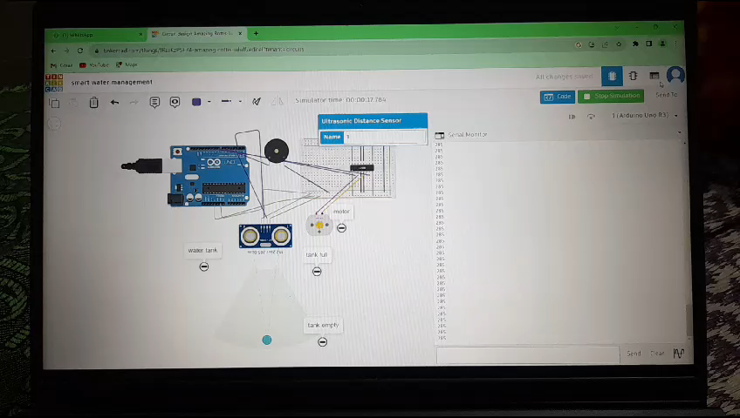
FINAL OUTPUT :

Slide 3
SOURCE CODE OF MQTT:

Slide 4
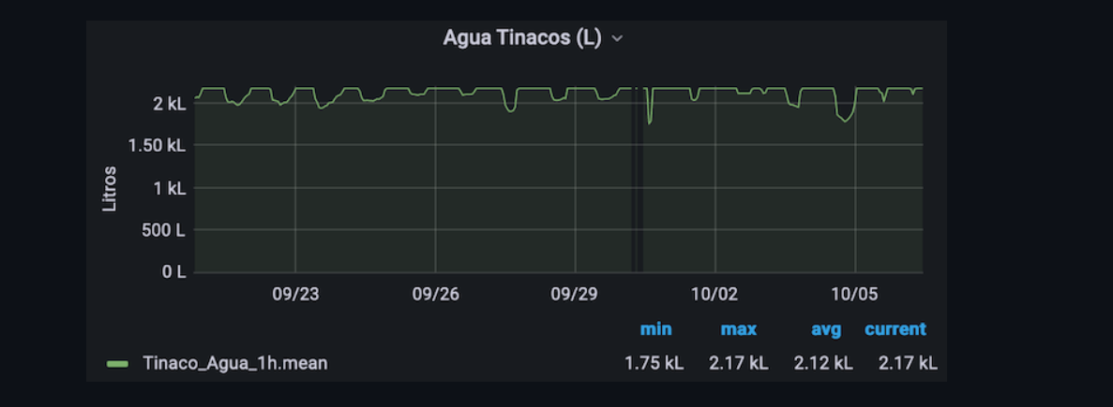
OUTPUT: Graphical representation of 15 days period analysis

